Slide 1

Thomas A. Beach
September 28, 2016
OPEN DATA INNOVATION SUMMIT & SOLUTIONS SHOWCASE

Slide 2
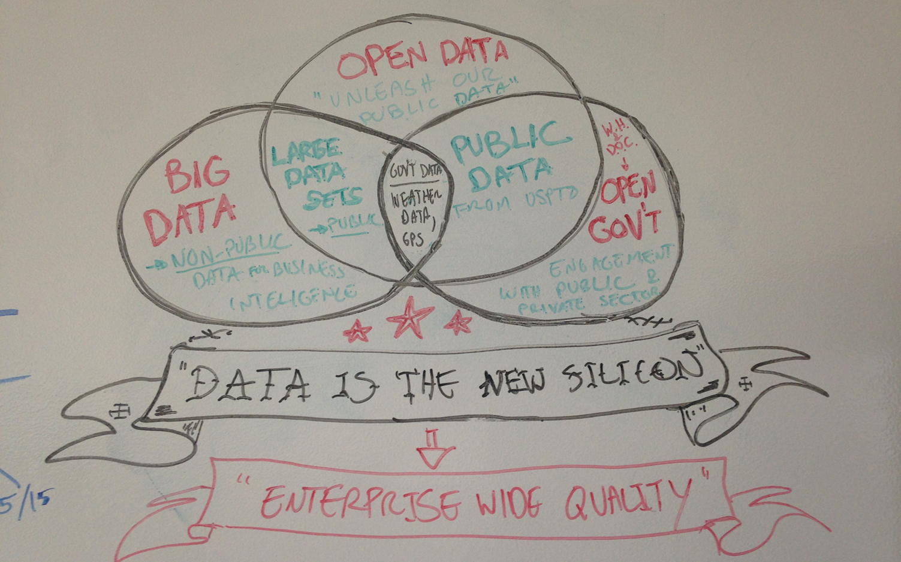
White House Open Data Summit

Slide 3

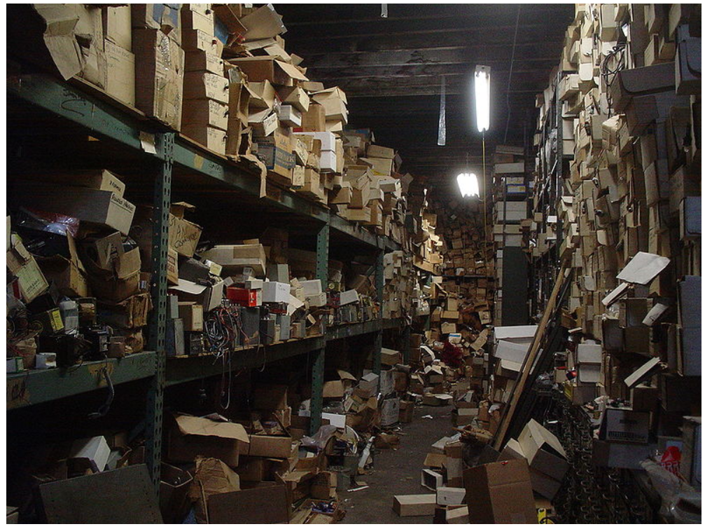

Slide 4


Slide 5
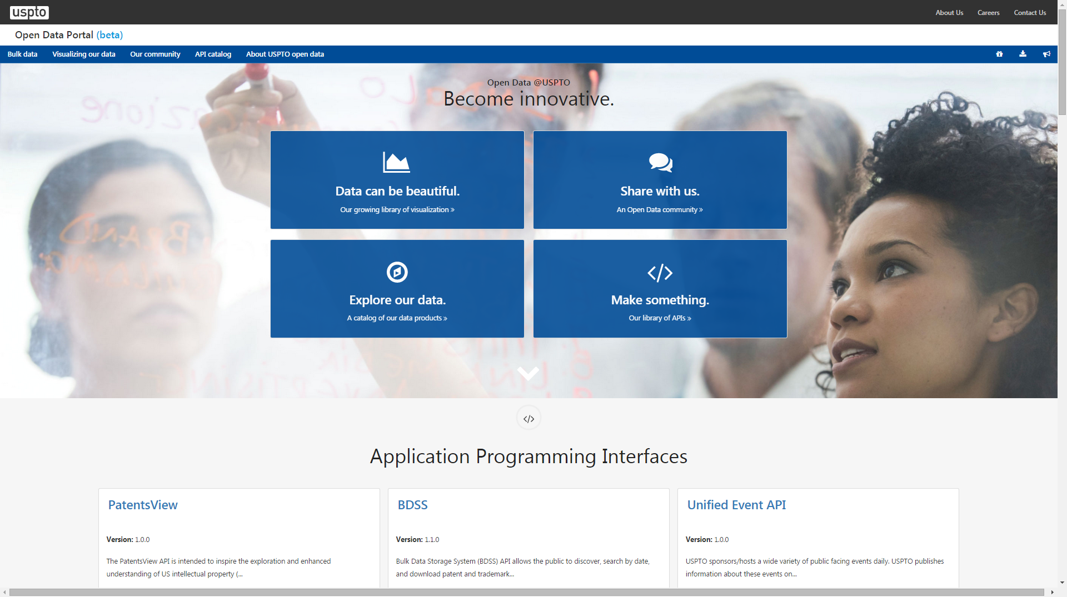
Developer Hub USPTO

Slide 6
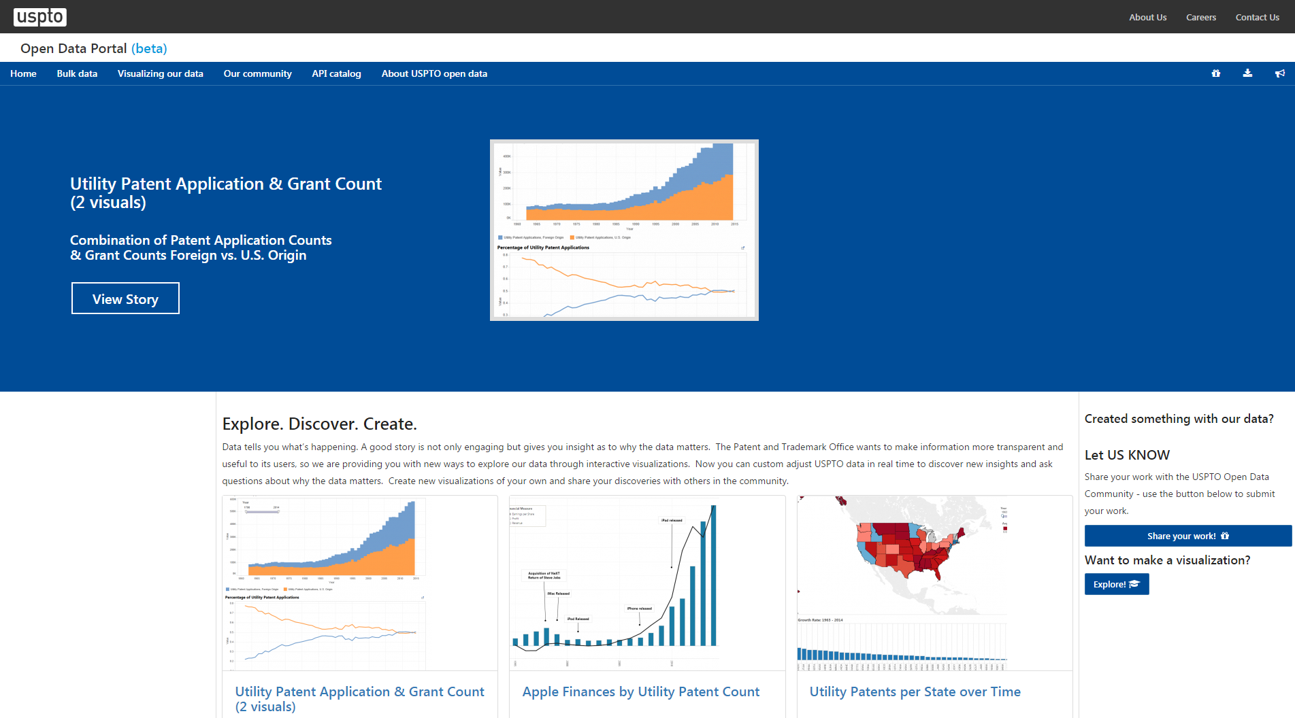
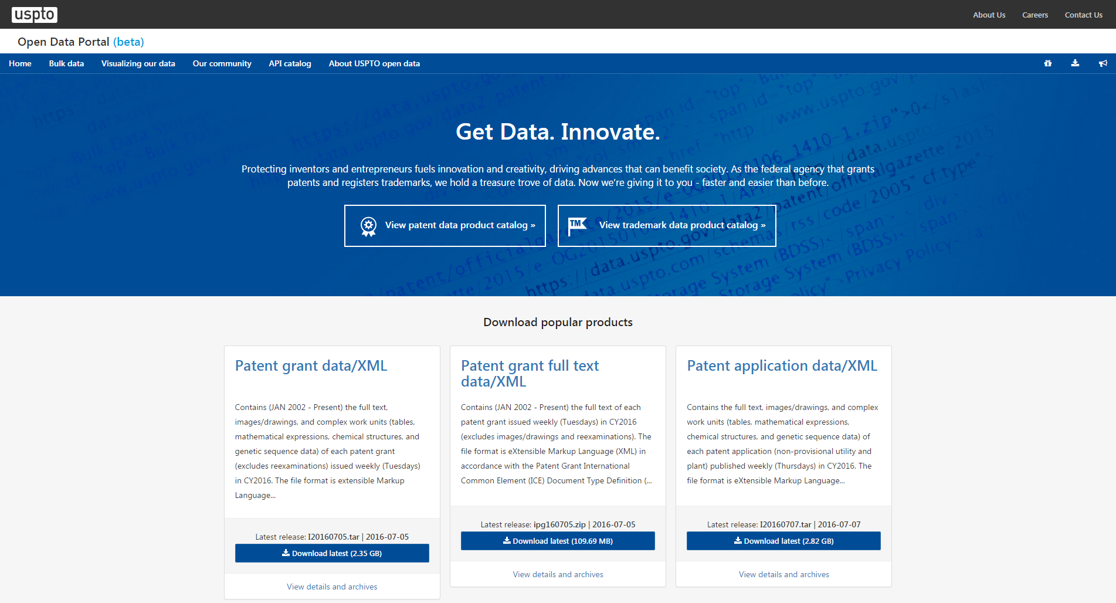
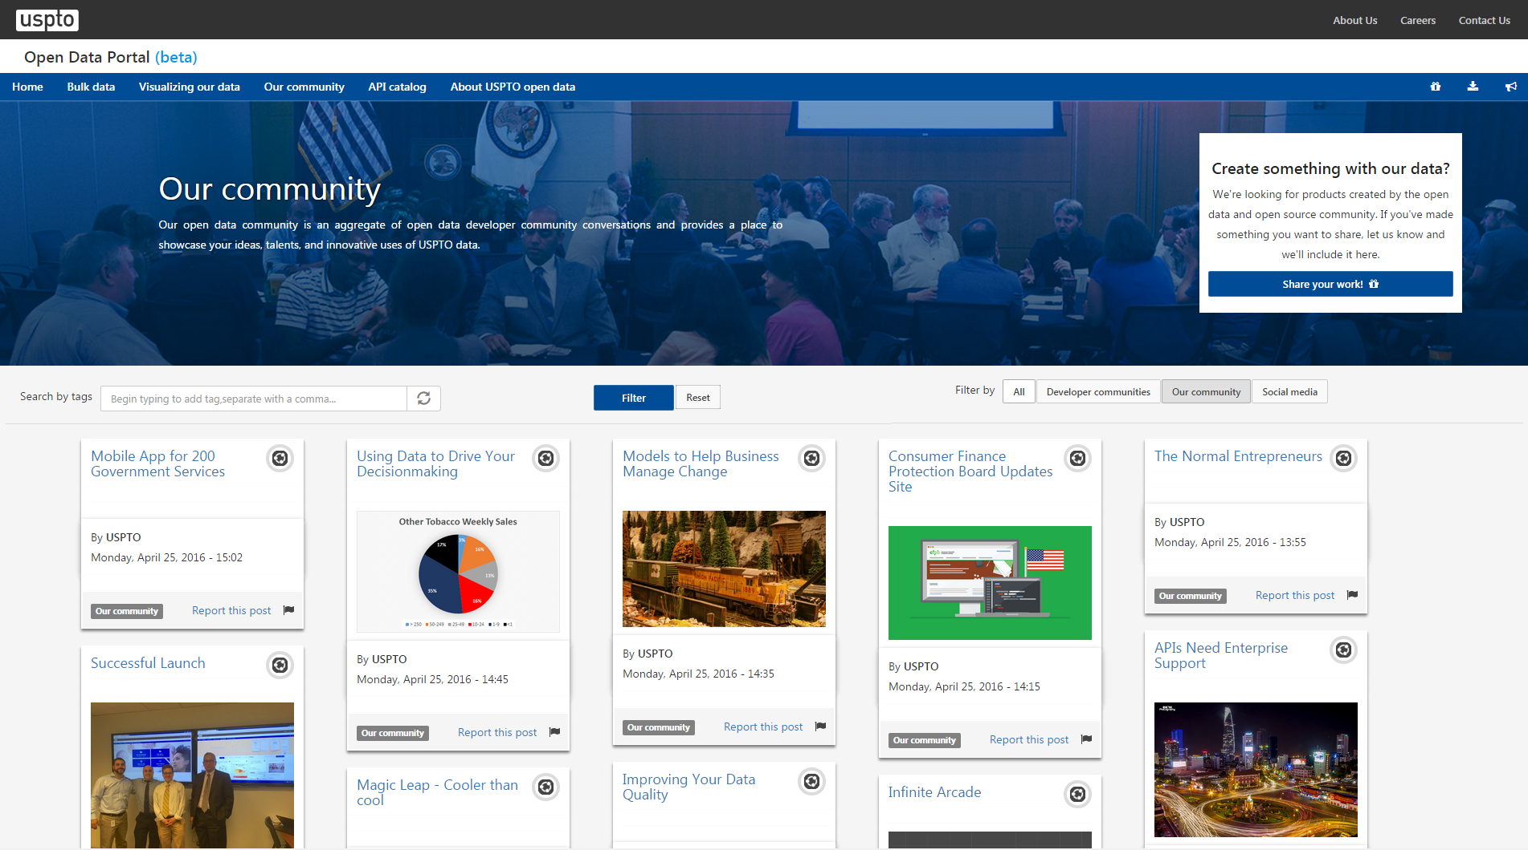
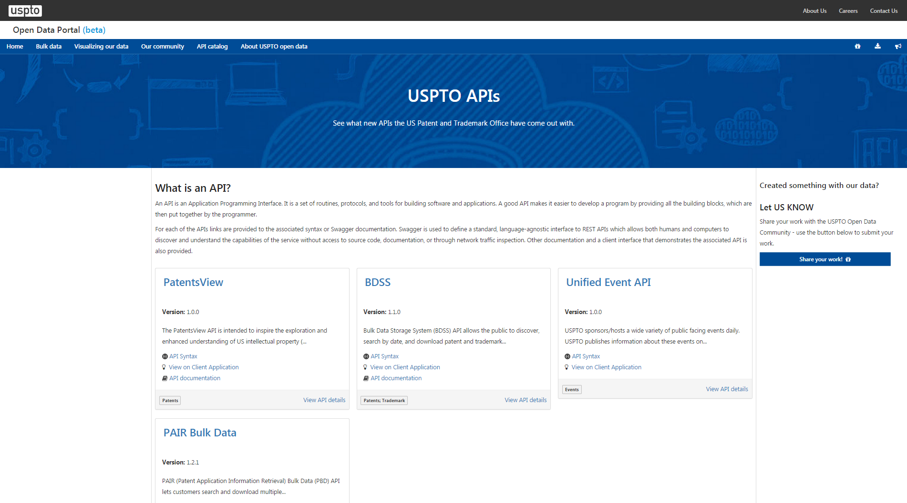
https://developer.uspto.gov/

Slide 7
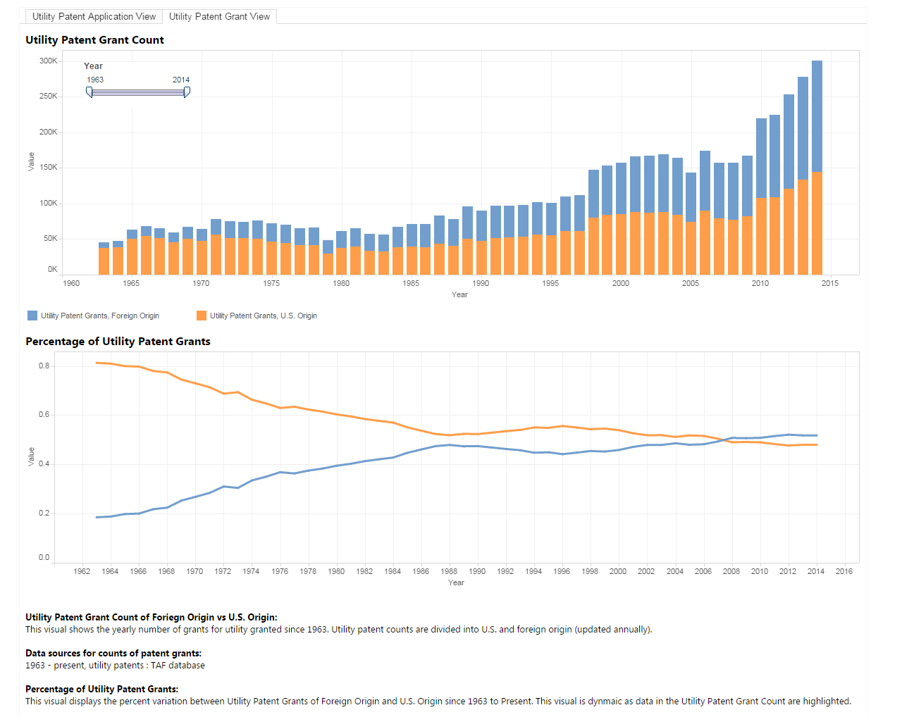
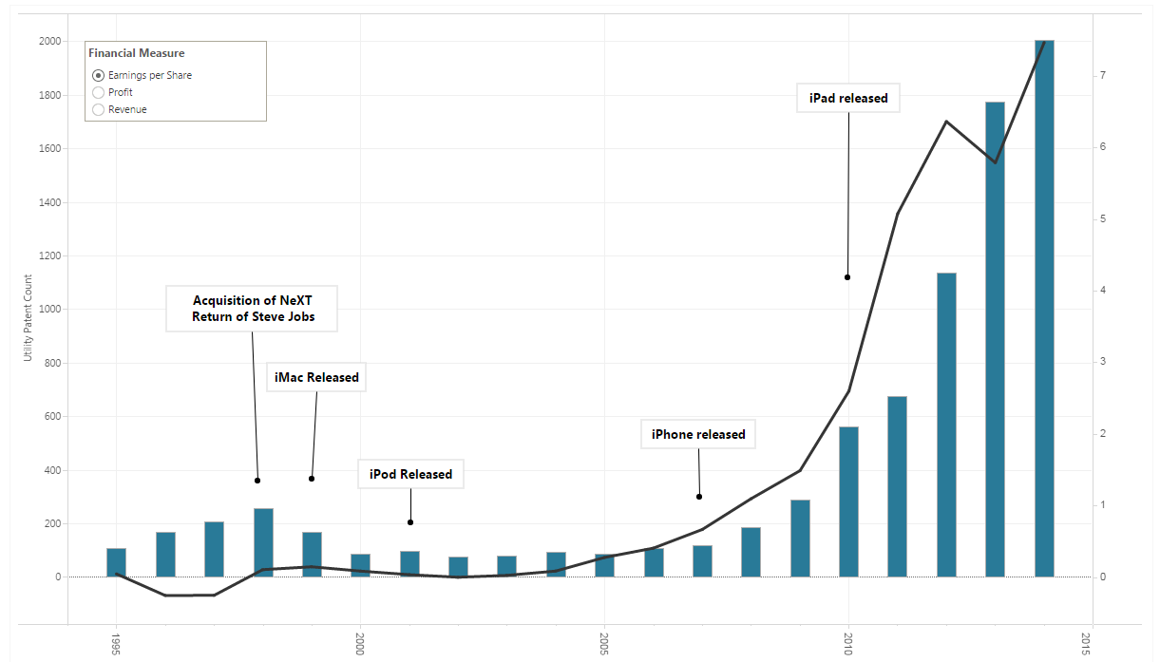
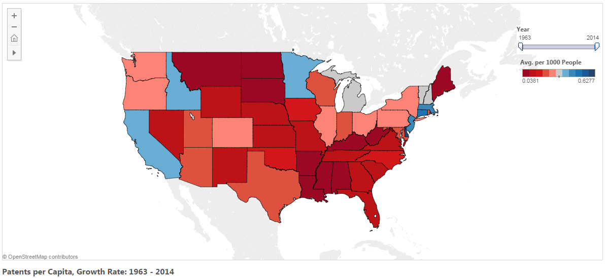
Examples of the Power of Story Telling with
USPTO Data and Economic Data
Apple Earnings per Share vs Utility Patent Count
Patents Granted from Domestic filers vs Foreign
Interactive Slider
Interactive
Selector
Patents per Capita, Growth Rate:
Utility Patents per State over Time

Slide 8
